Slide 1

CROP RECOMMENDATION
&
WEED DETECTION
PROJECT DOMAIN MACHINE LEARNING
SDG GOAL GOAL 2 - ZERO HUNGER
SAP NUMBER SAP020401
TEAM LEAD VISHWAJITH V
TEAM MEMBERS SURESH KRISHNAA R, ASWIN KUMAR S
Under the guidance of
DR. B. LATHA
PROFESSOR & HEAD/ Department of CSE

Slide 2

OUTLINE OF PRESENTATION
Objective
Problem Statement
Literature Survey
Proposed System Methodology
Overview of the project with block diagram
Approximate Budget
Work plan
References

Slide 3
Objective
It is very essential for the farmers to choose a crop that best suits the land being used for cultivation. Farmers should get benefited by cultivating the best fitting crops rather than cultivating the unsuitable crops.
The objective of this project is to develop a system which would be useful for farmers in order to predict the suitable crop, fertilizer and the crop yield.
Weeds results in yield reduction. We are using Image processing and Deep learning techniques which would extract the features that can distinguish between crop leaves and weed leaves.

Slide 4
Problem Statement
The common difficulty present among the Indian farmers is, they don’t opt for the proper crop based on their soil requirements. Due to this, they face a serious setback in productivity.
Choosing incorrect decisions would lead to crop failure, and this would result in complete loss to farmers.
Weeds are the plants growing in a wrong place which compete with crop for water, light, nutrients and space, causing reduction in yield. And in order to remove weeds, farmers started using deadly poisons as herbicides. By doing so they had success in increasing the productivity but they’ve forgotten the damage done to the environment.

Slide 5
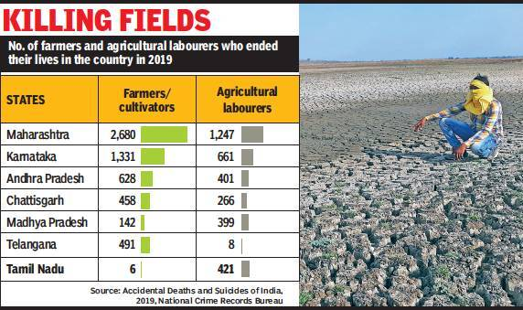
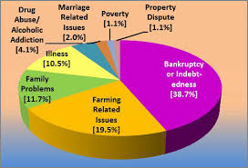
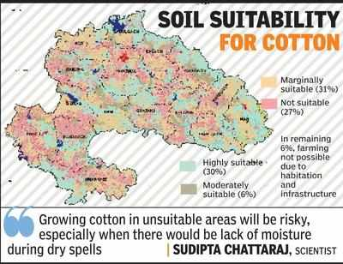
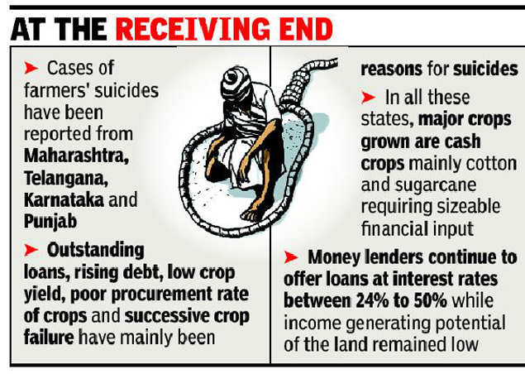
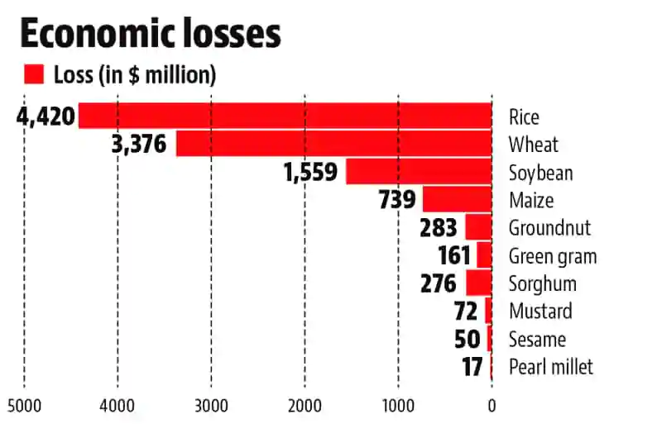
Why do we need this system?
A single misguided or incorrect decision taken by a farmer can have undesirable consequences contributing to the countless suicide cases of farmers that we hear from media on a daily basis.
A right decision in the selection of crops to be grown, will ultimately result in successful farming venture.
Total economic loss of about USD 11 billion was estimated due to weeds alone in 10 major field crops in 18 states of India. So, the control of weeds is of vital importance in agriculture.
CROP LOSS DUE TO WEEDS

Slide 6
Literature Survey
S. No. | Title | Author | Journal, Year | Methodology Used | Limitation/ Observation
1 | Agro Consultant: Intelligent Crop Recommendation System Using Machine Learning Algorithms | Zeel Doshi, et al., | 25 April 2019 Fourth International conference on Computing Communication Control and Automation (ICCUBEA) | To eliminate the aforementioned drawbacks, we propose Agro Consultant- which takes into consideration all the appropriate parameters, including temperature, rainfall, location and soil condition, to predict crop suitability. | This paper uses soil type and environmental factors for predicting crops, but the quality of crops is mainly dependent on the nutrients present in the soil, So we predict the crops using the NPK values.
2 | Crop Recommendation System through Soil Analysis Using Classification in Machine Learning | Dr. A. K. Mariappan,et al., | IEEE Access, Vol. 29, 2020 | The proposed system obtains the soil and crop parameters and maps those to list the suitable crops. | The system doesn’t recommend any fertilizers if the nutrients are low, then the system doesn't provide a feasible solution

Slide 7
S. No. | Title | Author | Journal, Year | Methodology Used | Limitation/ Observation
3 | Crop Recommendation and Fertilizer Purchase System | Mansi Shinde, et al., | Mansi Shinde et al, / (IJCSIT) International Journal of Computer Science and Information Technologies, Vol. 7 (2) , 2016. | This paper summarizes an efficient recommendation system for fertilizers and crops based on the NPK values and region. This application also allows users to purchase the recommended fertilizers from the purchase portal. | The system recommends fertilizer based on previous purchase which is not feasible to provide appropriate fertilizer for a particular crop.
4 | AGRIGRASS: Precision Farming for Weed Detection & Control | Margesh M. Ambilwade, et al., | International Journal of Future Generation Communication and Networking Vol. 13, No. 3s, (2020) | In this system, Feature Extraction is done using CNN. Features such as color, shape, size of a particular weed are extracted and then weed classification is done using KNN algorithm. | The proposed system doesn’t store the solution provided to a specific weed which can be used in the future if the same kind of weed occurs. This system will give a precise solution to weeds which tends to grow in a large number of area.

Slide 8
S. No. | Title | Author | Journal, Year | Methodology Used | Limitation/ Observation
5 | Image Processing for Weed Detection | R.Anirudh Reddy,et al., | International Journal of Engineering Technology, Management and Applied Sciences, April 2017, Volume 5, Issue 4, ISSN 2349-4476 | This paper introduces the system implementation of image processing technique for weed detection and removal. It involves simple edge detection technique using various filters such as Gaussian and Laplacian. It finally concludes with the feature extraction, results that implement ORB algorithm. | This system, uses ORB algorithm for feature extraction, it can use a more efficient algorithm in the preprocessing stage.
6 | Crop Recommendation System to Maximize Crop Yield using Machine Learning Technique | Rohit Kumar Rajak,et al., | International Research Journal of Engineering and Technology (IRJET) Volume: 04 Issue: 12 | Dec-2017 | In this paper, the data from soil testing lab is given to the recommendation system it will use the collected data and do ensemble model with majority voting technique using support vector machine (SVM) and ANN as learners, to recommend a crop for site specific parameter with high accuracy and efficiency. | This paper uses a small dataset with less number of attributes or features.

Slide 9
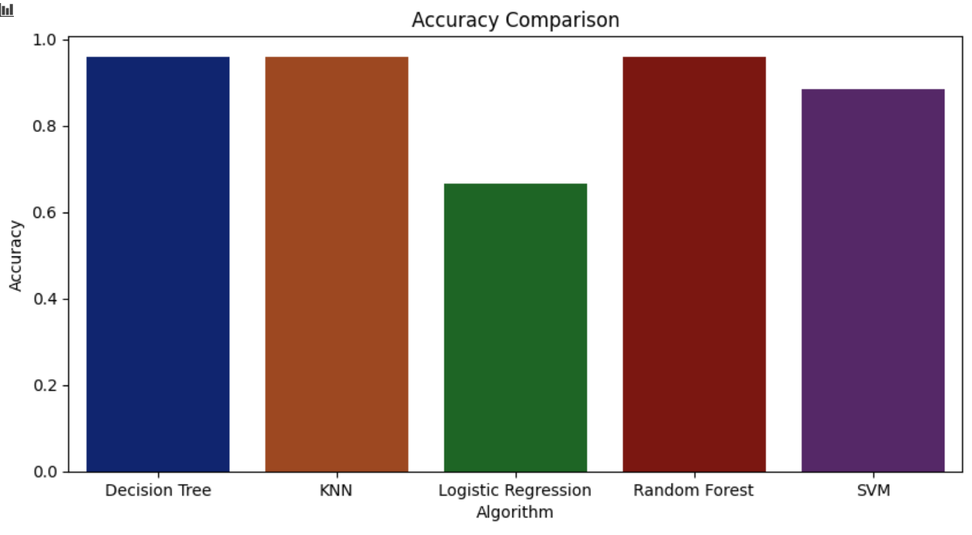
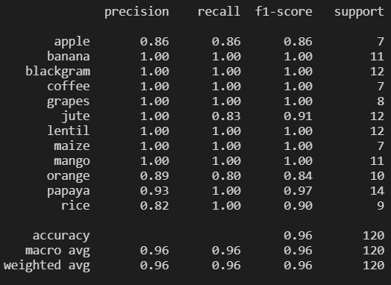
Proposed System Methodology
CROP RECOMMENDATION
Crop Recommendation
To predict the most suitable crop, we use two different approaches,
Approach 1
Step 1:
Process - Recommend a crop considering the environmental factors such as temperature, humidity and rainfall (predicted using Weather API).
Algorithm - Random Forest (Classification).
Reason - RF is an ensemble classifier, which is a most effective algorithm as it uses bagging approach to solve the problem.
Accuracy Score - 95.83%
CROP RECOMMENDATION
Random Forest

Slide 10
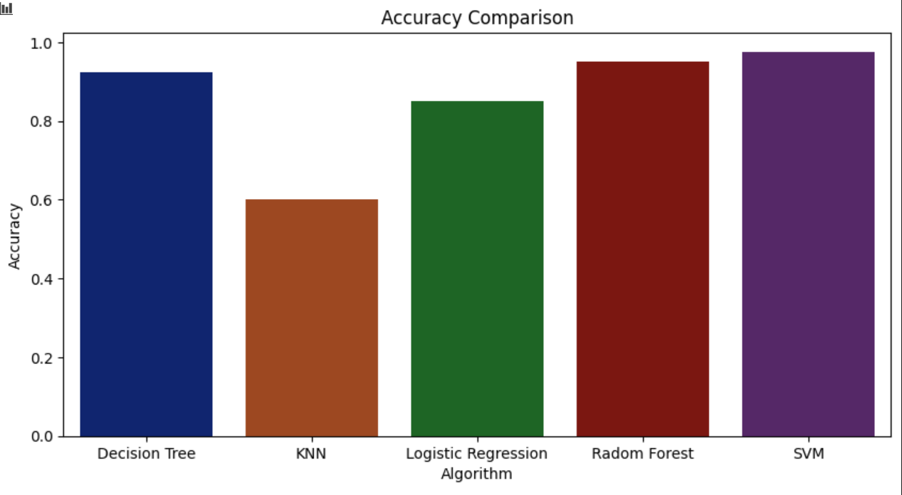
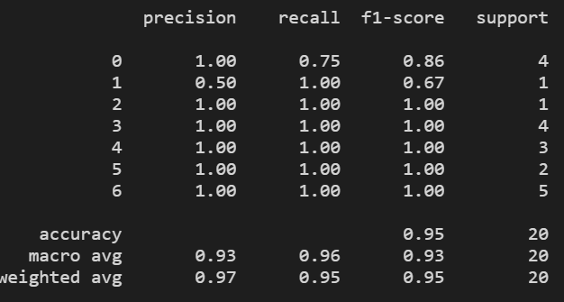
Step 2:
Process - Predict the ideal NPK values based on environmental factors and previously predicted crop.
Algorithm - Gradient Boosting Regressor
Reason - GBR uses weak learners as classifiers, and they learn from their previous mistakes.
Step 3:
Process - Recommend a fertilizer based on the environmental factors, soil type and crop type.
Algorithm - Support Vector Machines
Reason - SVM will have higher accuracy when we have many features(high dimensional spaces).
Accuracy Score- 97.5%
FERTILIZER RECOMMENDATION
Support Vector Machine (SVM)

Slide 11
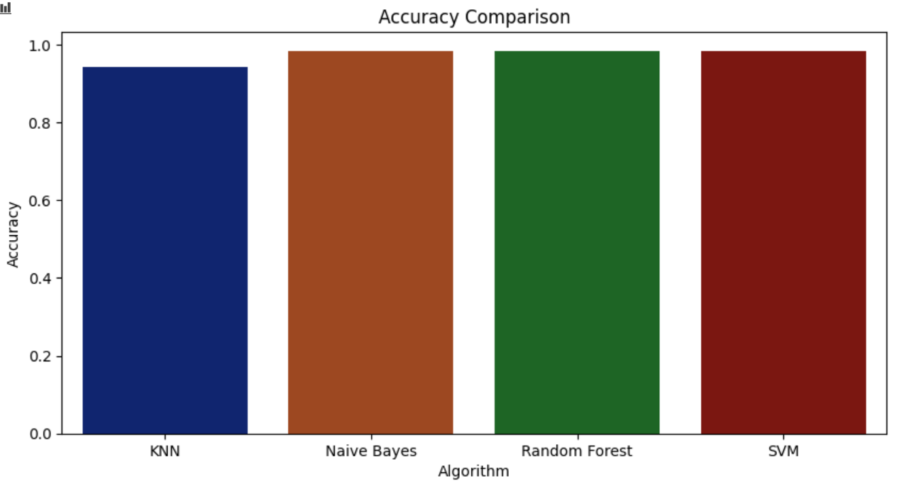
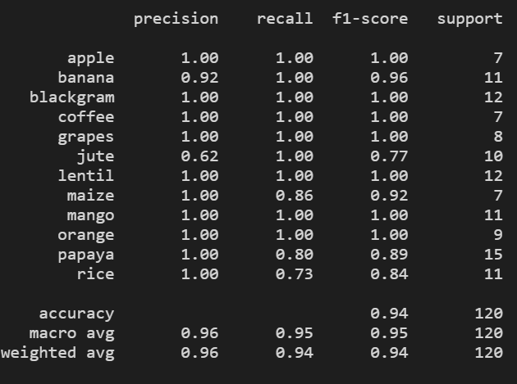
CROP RECOMMENDATION
Approach 2
Step 1:
Collect the NPK values from the farmer.
Step 2:
Process - Predict a best suitable crop based on the NPK values and environmental factors(temperature, humidity, rainfall).
Algorithm - Random Forest
Reason - Random Forest uses ensemble approach, so it has a very good accuracy compared to other algorithms.
Accuracy Score - 98.33%
Random Forest

Slide 12
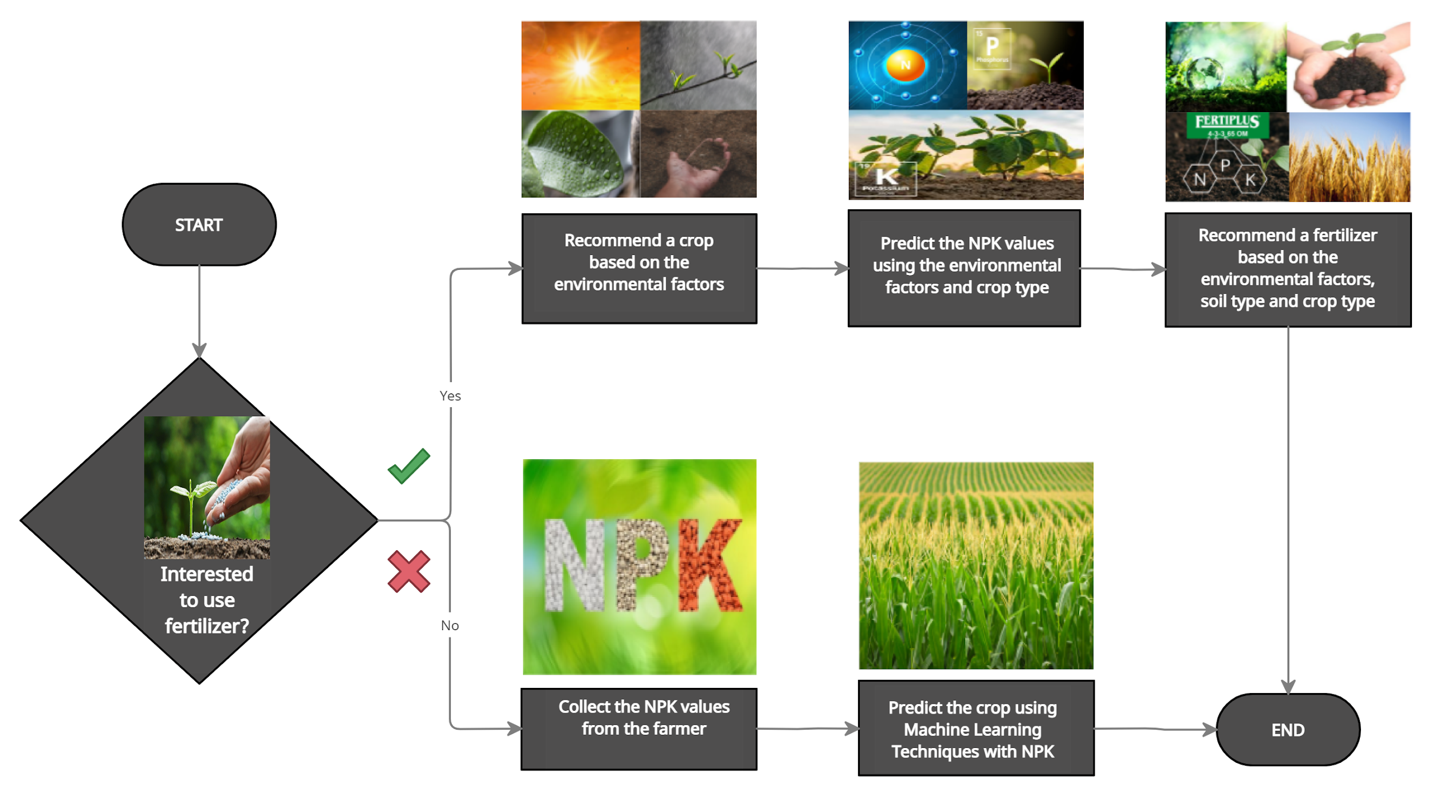
Flowchart - Crop Recommendation

Slide 13
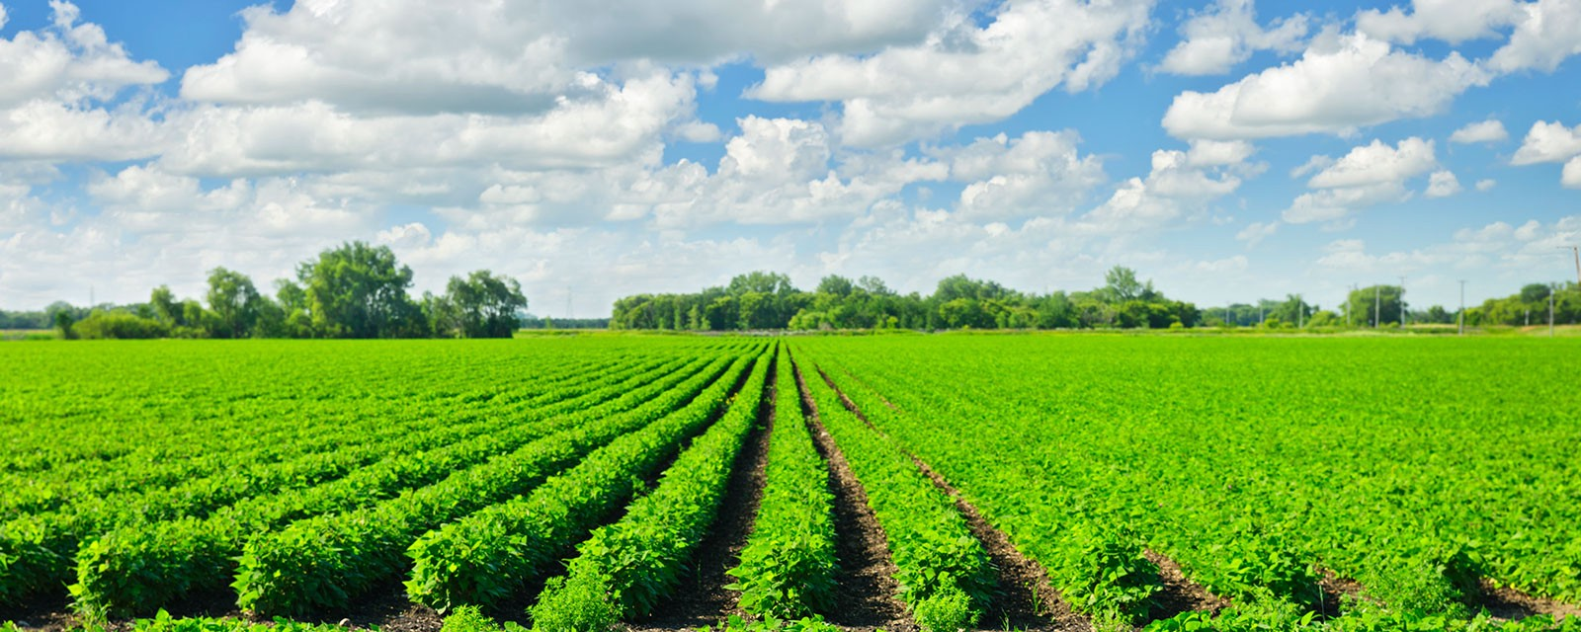
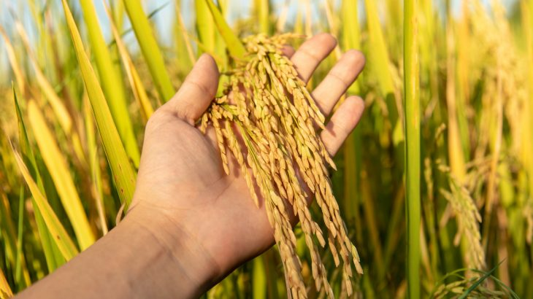
CROP YIELD / PRODUCTION
We also predict the amount of crop that the farmer can cultivate, this prediction is based on the farmer’s location, seasonal changes, crop type and the amount of area used for cultivation.
This prediction would help to take fair and correct decisions which would make their yield more productive.
So based on this the farmer can decide whether to go ahead with the chosen crop or to choose a different crop.
And here we use SGD - Stochastic Gradient Descent Algorithm to predict the value of crop yield and this regression analysis is based on crop type, location, area and season.

Slide 14
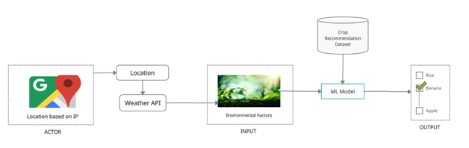
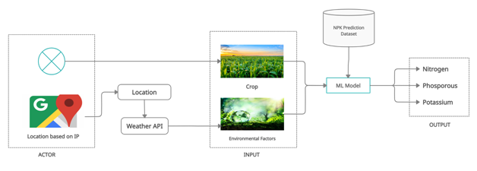
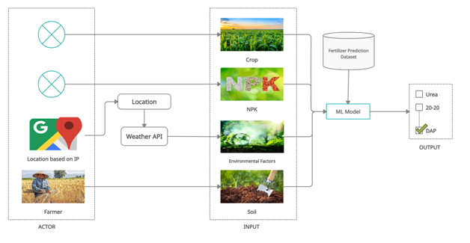
Architecture Diagram - Crop Recommendation Approach 1

Slide 15
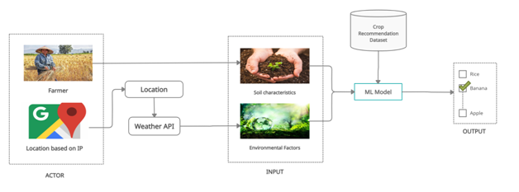
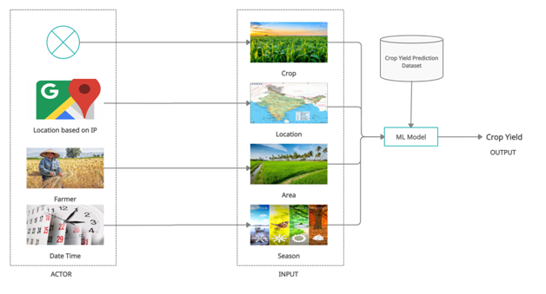
Architecture Diagram - Crop Recommendation Approach 2
Architecture Diagram - Crop Production

Slide 16
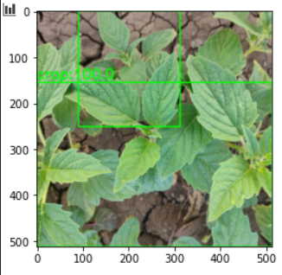
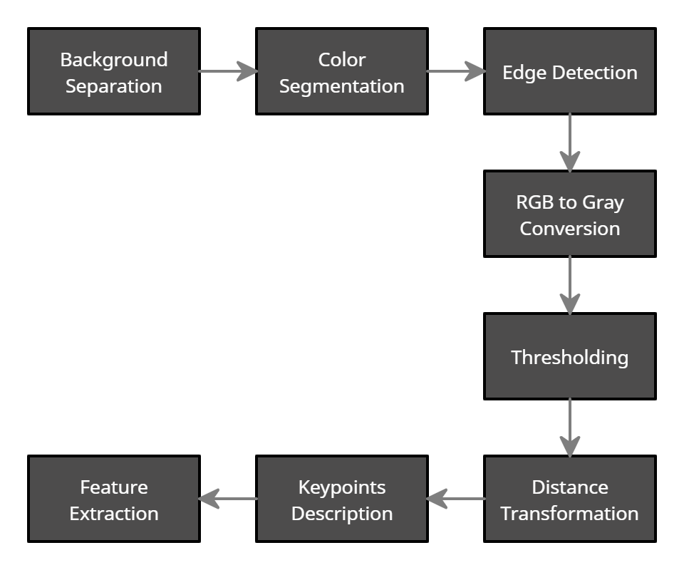
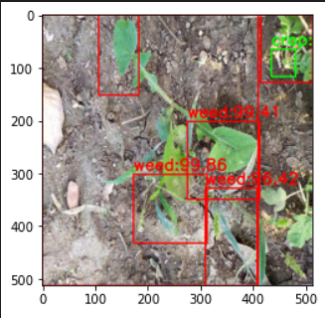
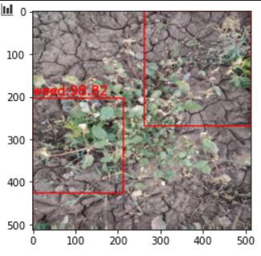
CROP - WEED DETECTION
Weed detection is very much helpful for farmers for boosting their annual production.
In this project, we use OpenCV image processing techniques which does the following operations,
Then we use a deep learning model, which has multiple layers to progressively extract high-level features from the input image, and using these features crop-weed classification is carried out.

Slide 17




Hardware and Software Requirements
Software
OpenCV
Keras
Scikit Learn
Flask
Tools used - Jupyter NoteBook ( Anaconda ), VScode
Hardware
System - Intel Core i3 processor, 8GB RAM,
1.10 GHz CPU speed
Camera - 12MP

Slide 18
Work plan - Project Modules
Module 1
Crop prediction training, modeling and testing.
Determining required NPK concentration of soil for the predicted crop.
Determining the most suitable fertilizer on lack of NPK.
Module 2
Weed detection algorithm - training and testing.
Module 3
Crop production algorithm

Slide 19
References
[1] Z. Doshi, S. Nadkarni, R. Agrawal and N. Shah, "Agro Consultant: Intelligent Crop Recommendation System Using Machine Learning Algorithms," 2018 Fourth International Conference on Computing Communication Control and Automation (ICCUBEA), Pune, India, 2018, pp. 1-6, doi: 10.1109/ICCUBEA.2018.8697349.
[2] Dr. A. K. Mariappan, Ms. C. Madhumitha, Ms. P. Nishitha, Ms. S. Nivedhitha, “Crop Recommendation System through Soil Analysis Using Classification in Machine Learning”, IJAST, vol. 29, no. 3, pp. 12738 - 12747, Mar. 2020.
[3] Mansi Shinde, Kimaya Ekbote, Sonali Ghorpade, Sanket Pawar, Shubhada Mone, “Crop Recommendation and Fertilizer Purchase System”, IJAST, vol. 7, no. 2, pp. 665-667, 2016.
[4] Margesh M. Ambilwade, Aumkar A. Deshpande, Rucha K. Ugemuge, Pooja N. Vengurlekar “AGRI GRASS: Precision Farming for Weed Detection & Control”, International Journal of Future Generation Communication and Networking Vol. 13, No. 3s, (2020), pp. 121–127.
[5] R.Anirudh Reddy, G.Laasya, T.Sowmya, P.Sindhuja, Mudasar Basha, “Image Processing For Weed Detection”, International Journal of Engineering Technology, Management and Applied Sciences, April 2017, Volume 5, Issue 4, ISSN 2349-4476.
[6] Rohit Kumar Rajak, Ankit Pawar, Mitalee Pendke, Pooja Shinde, Suresh Rathod, Avinash Devare, ”Crop Recommendation System to Maximize Crop Yield using Machine Learning Technique”, International Research Journal of Engineering and Technology (IRJET), Volume: 04 Issue: 12 | Dec-2017.

Slide 20
ABSTRACT SUBMITTED: YES
BASE PAPER SUBMITTED: YES
SDG : GOAL 2 - ZERO HUNGER - END HUNGER, ACHIEVE FOOD SECURITY AND IMPROVED NUTRITION AND PROMOTE SUSTAINABLE AGRICULTURE.
DOMAIN: MACHINE LEARNING
SOCIAL RELEVANT: YES ( AGRICULTURE )
PATENT: NO
PUBLICATION DETAILS:
COMPANY: NO
GOVERNMENT: NO

Slide 21


